Slide 1


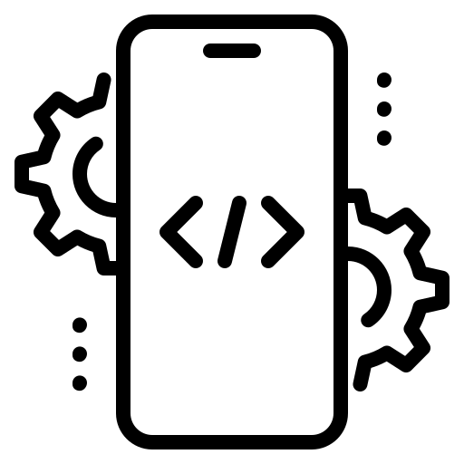
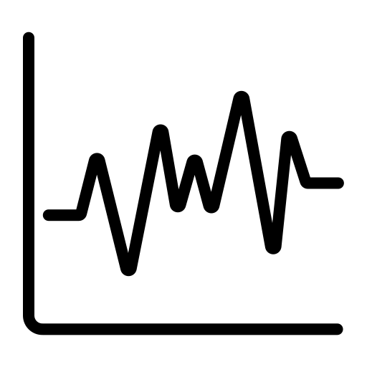


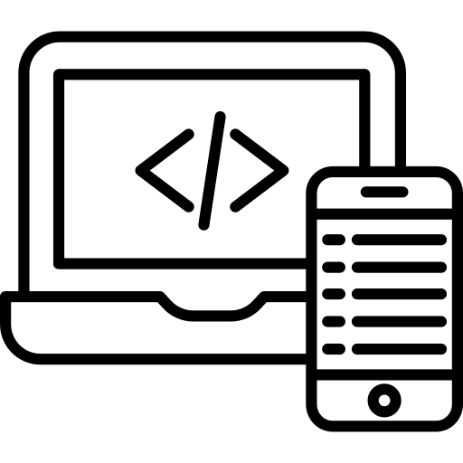
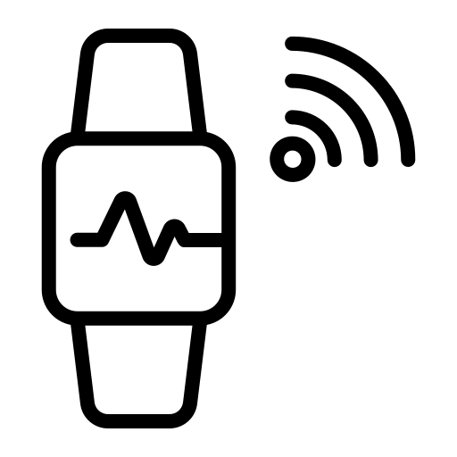


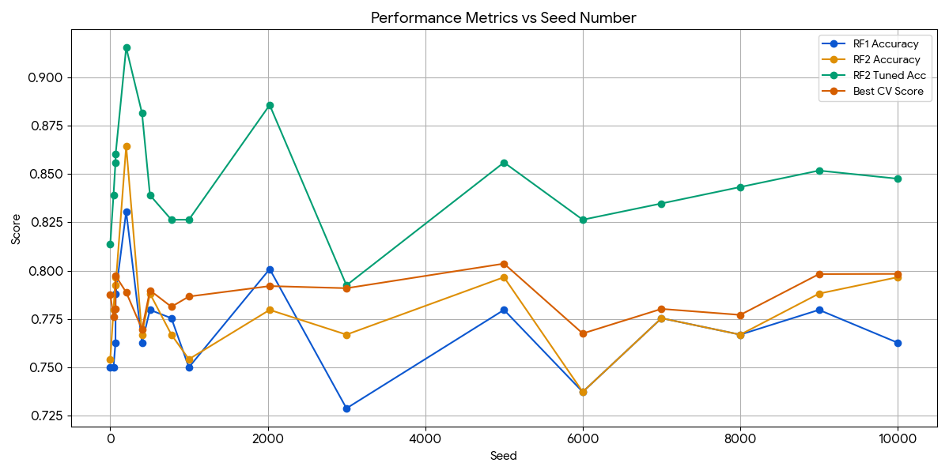


Breaking Communication Barriers
A Mobile-Based Translation System Using EMG Signal Processing and Machine Learning
Project Team
Author: S. Truc Deydeepya Lakshmi
Student ID: 25195661/1
Supervisor: Dr. Vi Chi Thanh
Introduction
The United Nations Convention on the Rights of Persons with Disabilities recognizes sign languages as a basic human right essential for social inclusion. Despite rapid technological evolution, a profound communication barrier persists between sign language users and the hearing world. Hence, this project aims to design, develop and evaluate SignLink, an intelligent sign language translation system that utilizes ML and EMG-based gesture recognition to translate sign language gestures into text and speech through an Android mobile application.
Methodology
Objectives
The native Android app uses an MVVM architecture and Nielsen’s heuristics to provide an intuitive interface for hardware calibration, BLE connectivity, and real-time translation, integrating TTS/STT and a local RoomDB for personalized user data management.
Research and requirements analysis of system components. | Develop an assisting Android mobile application. | Build multiple EMG-collecting hardware iterations. | Train an ML model to classify gestures from EMG data. | Analyze user feedback & preferences to fine-tune system.
Hardware development followed three iterative phases: V1
established a single-sensor baseline using an Arduino Uno; V2 scaled to four sensors on a breadboard; and V3 refined the design into a compact, organized configuration utilizing three optimized EMG sensors.
The model utilizes a Random Forest classifier trained on EMG/IMU sensor data, optimized through multi-window statistical feature engineering and SelectFromModel attribute reduction. To address inter-user signal variability, we implemented an intra-user classification strategy requiring a personalized calibration phase, which ensures high-accuracy, real-time gesture recognition.
Results
Evaluation
Rigorous evaluation across 17 random data splits yielded a robust final accuracy of 84.67% ± 2.80%. The stability of these cross-validation scores as visualized in the graph below confirms the model's dependability, ruling out data leakage and validating its efficacy for real-time translation.
Initial pilot testing with 5 users refined core UI concepts on high-fidelity prototypes, while subsequent trials with 15 users validated the final application’s translation workflows and interface accessibility.
Model performance was validated using multi-fold cross-validation, comparing baseline and optimized Random Forest configurations to ensure consistent accuracy, precision, and recall across diverse data folds.
Conclusion & Future Work
The initial pilot study validated our core design with an excellent SUS score of 89.0, while iterative refinements to the calibration wizard and interface clarity propelled the final evaluation to a SUS score of 96.8. This progression demonstrates the effectiveness
SignLink provides a practical framework for real-time sign language translation by integrating custom EMG hardware with a robust mobile ML engine. Future iterations will refine hardware reliability and ergonomics, while expanding the system to include multi-language support and video-based translation to ensure universal accessibility.
of our user-centered improvements in achieving a more seamless and intuitive communication experience.
https://rombolabs.github.io/#project · https://docs.backyardbrains.com/retired/experiments/RobotHand/ · https://www.youtube.com/watch?v=0FsTPQY1bJw · https://doi.org/10.1145/3025171.3025216 · https://www.un.org/development/desa/disabilities/convention-on-the-rights-of-persons-with-disabilities.html

